Slide 1
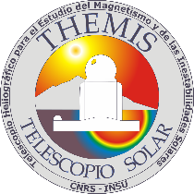



THEMIS solar telescope A new era begins
FSLAC
International
Research Lab.
Journées de la SF2A – S08 – Toulouse – July 3rd 2025
Étienne Pariat^{1,2}, B. Gelly¹, R. Douet¹, D. Laforgue¹
¹ French-Spanish Laboratory for Astrophysics in Canarias (FSLAC), CNRS, IAC, La Laguna, Tenerife, ES
² Laboratoire de Physique des Plasmas, Sorbonne Université, École polytechnique, Institut Polytechnique de Paris, Université Paris Saclay, Observatoire de Paris-PSL, CNRS, Paris, France

Slide 2
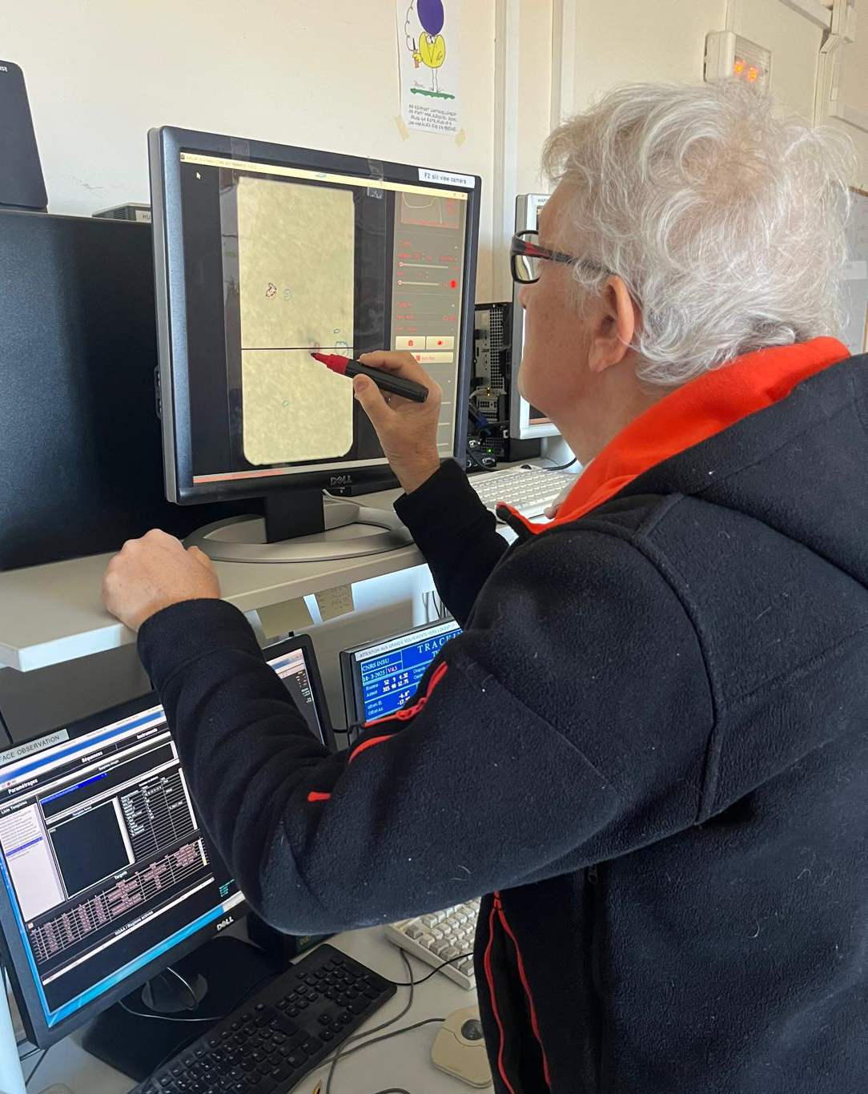
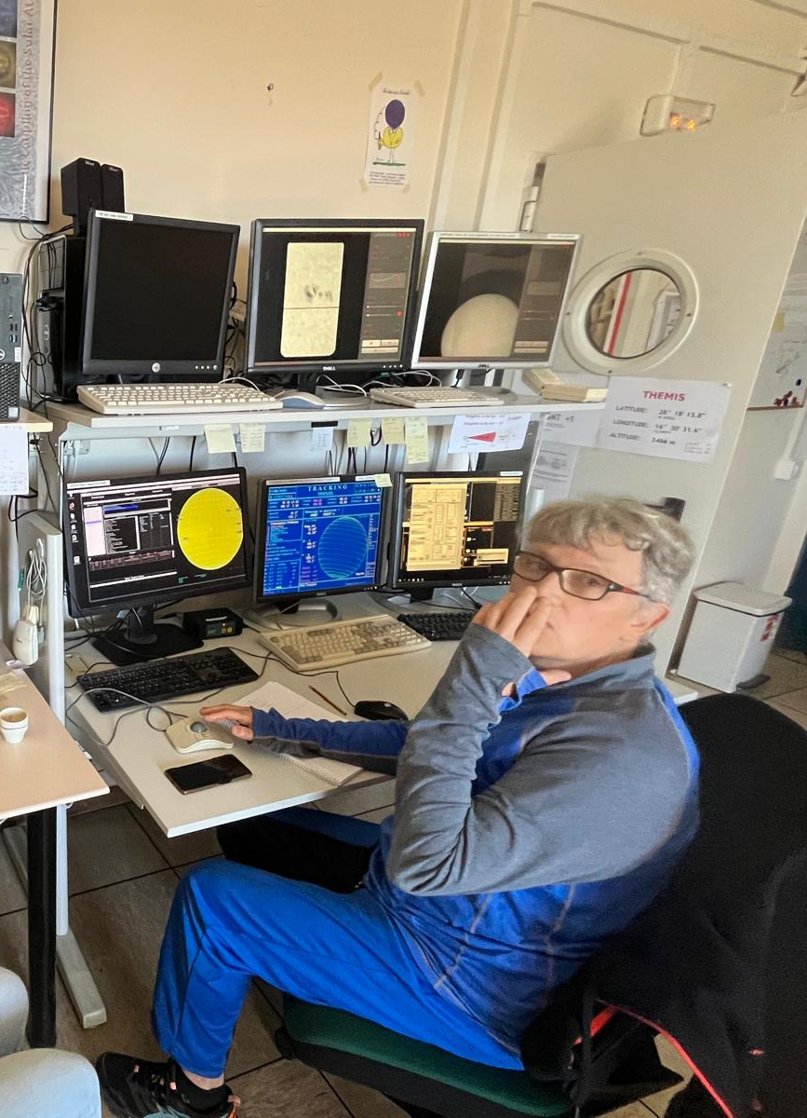
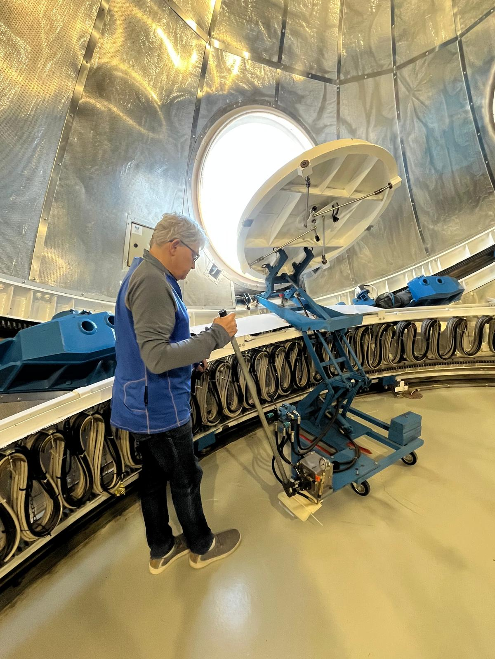
In memoria of Didier Laforgue
Didier Laforgue passed away on June 20th 20205, after 23 years working at THEMIS as a system-instrument research engineer, and as a very appreciated observation operator.

Slide 3
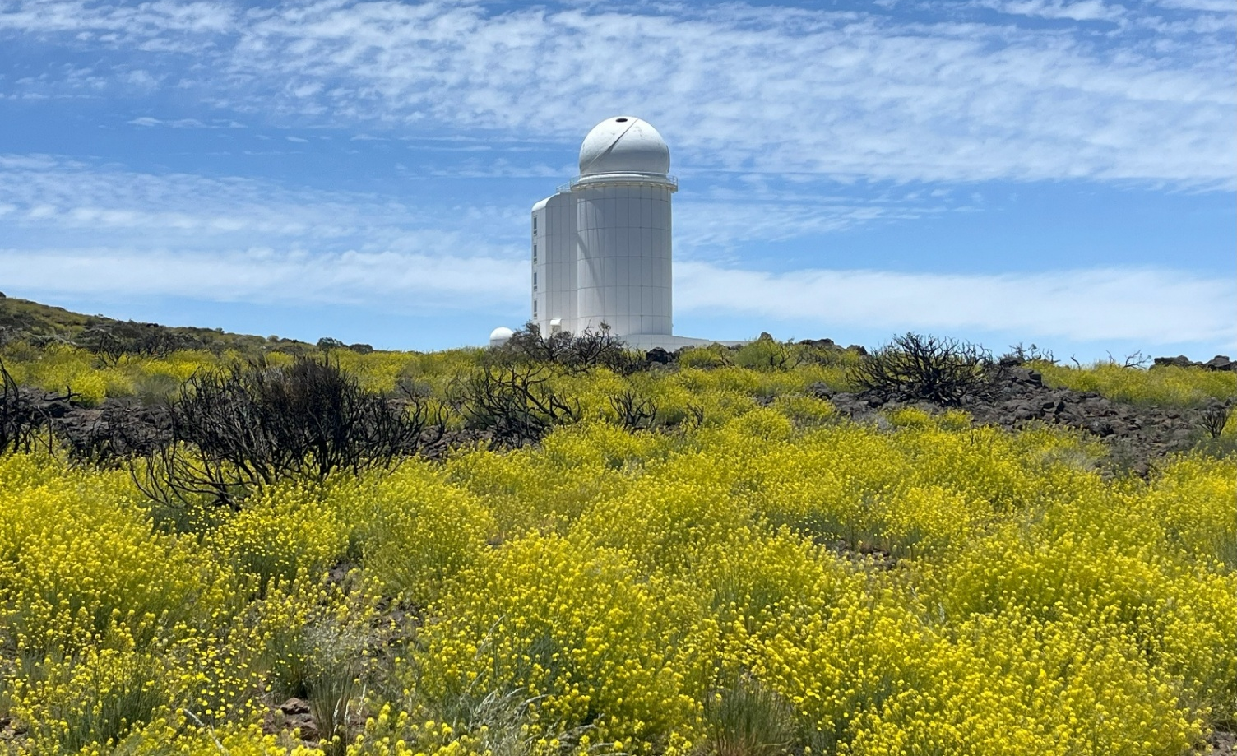
THEMIS Factsheet
Very well-maintained but,
be at that it may,
a 20th century instrument !
Main French solar telescope designed by J. Rayrole, P. Mein & M. Semel
Located at Teide Observatory, Tenerife, Spain
1st light in March 1996, & commissioned in 99
1m-class solar telescope, with one the world “slowest” optical design:
Aperture: 92 cm
Effective focal length: 57m
Effective focal ratio: f/62
Ideal for high resolution spectropolarimetry:
Ultra-high spectral resolving power: R ~ 200 000 to 300 000
Simultaneous obs. of user-defined set of up to 6 spectral lines: 6-7 Å range, 4 mÅ/pixel
Spectrum range: 400-1100 nm
2’x2’ square field-of-view
THEMIS @ OT in June 2025

Slide 4
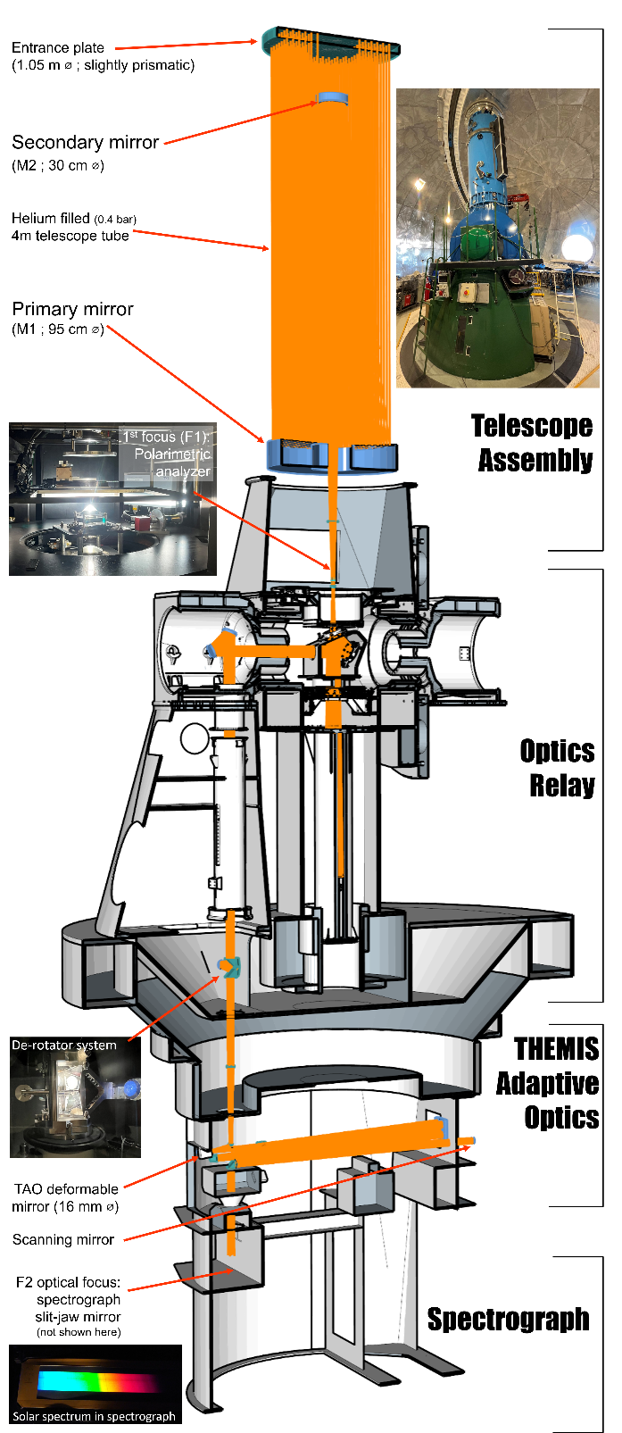
“Total makeover”: 2016 → 2020
THEMIS has been widely renewed and redesigned
Thanks to EU collaborative funding: ~1M€ from 2 SOLARNET programs
Successful renovation thanks to several French teams

Slide 5
“Total makeover”: 2016 → 2020
THEMIS has been widely renewed and redesigned
Thanks to EU collaborative funding: ~1M€ from 2 SOLARNET programs
Successful renovation thanks to several French teams
M2 mirror re-aluminising (William Hershel Telescope & THEMIS teams)

Slide 6
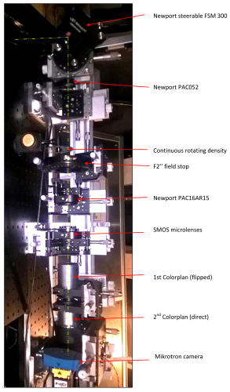
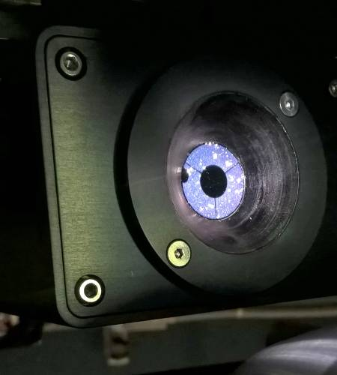
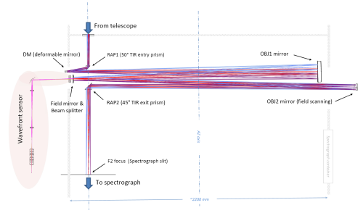
“Total makeover”: 2016 → 2020
THEMIS has been widely renewed and redesigned
Thanks to EU collaborative funding: ~1M€ from 2 SOLARNET programs
Successful renovation thanks to several French teams
M2 mirror re-aluminising (WHT & THEMIS teams)
Themis Adaptive Optics: “classical” (single-DM) adaptive optics based on innovative wavefront sensing and mirror commanding concepts (AIRI@CRAL & THEMIS)

Slide 7
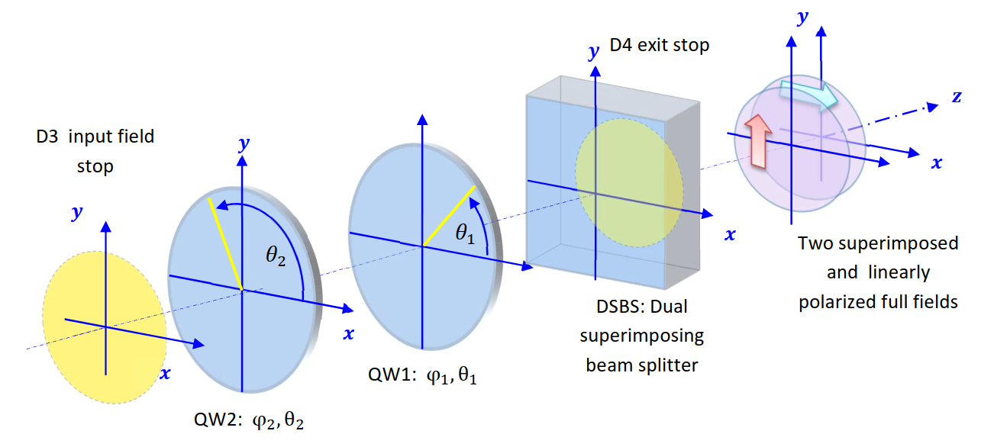
“Total makeover”: 2016 → 2020
THEMIS has been widely renewed and redesigned
Thanks to EU collaborative funding: ~1M€ from 2 SOLARNET programs
Successful renovation thanks to several French teams
M2 mirror re-aluminising (WHT & THEMIS teams)
Themis Adaptive Optics: “classical” (single-DM) adaptive optics based on innovative wavefront sensing and mirror commanding concepts (AIRI@CRAL & THEMIS teams)
Superimposed dual-beam polarimetric analysis without field limitation (Semel M., Lopez A., Le Men C. & THEMIS)

Slide 8
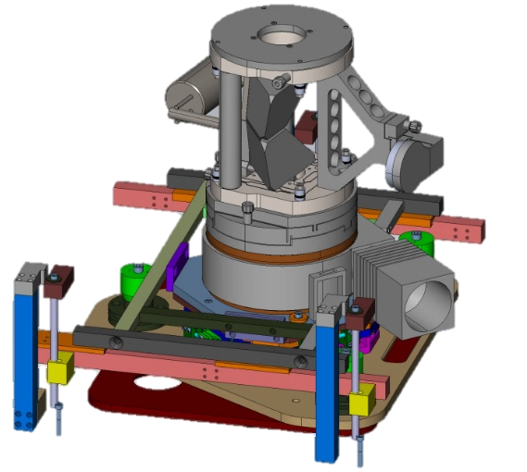
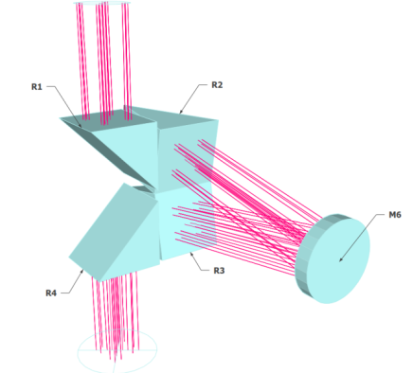
“Total makeover”: 2016 → 2020
THEMIS has been widely renewed and redesigned
Thanks to EU collaborative funding: ~1M€ from 2 SOLARNET programs
Successful renovation thanks to several French teams
M2 mirror re-aluminising (WHT & THEMIS teams)
Themis Adaptive Optics: “classical” (single-DM) adaptive optics based on innovative wavefront sensing and mirror commanding concepts (AIRI@CRAL & THEMIS teams)
Superimposed dual-beam polarimetric analysis without field limitation (Semel M., Lopez A., Le Men C. & THEMIS)
“Polarization- friendly” complete redesign of the whole transfer optics (M3, M4 & M5) (Le Men, C. & THEMIS)
New de-rotator system (THEMIS)
+ New context, broadband and spectral cameras.

Slide 9
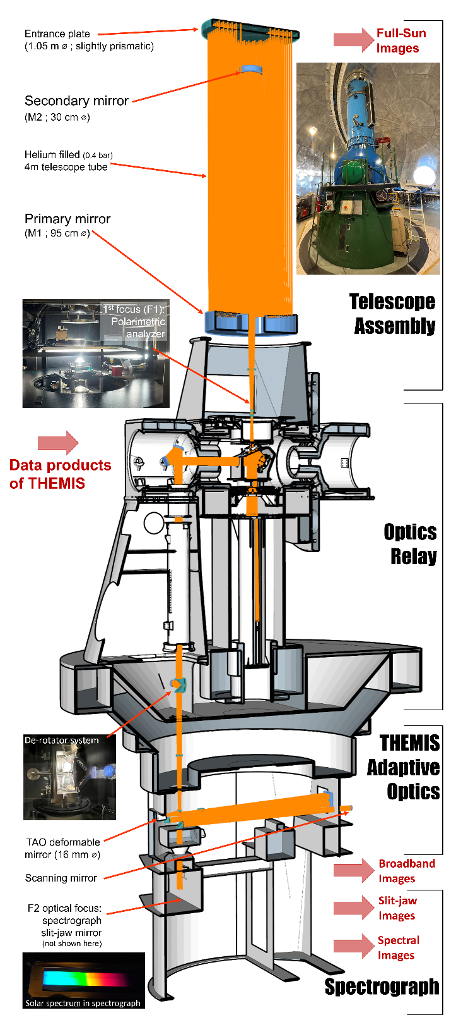
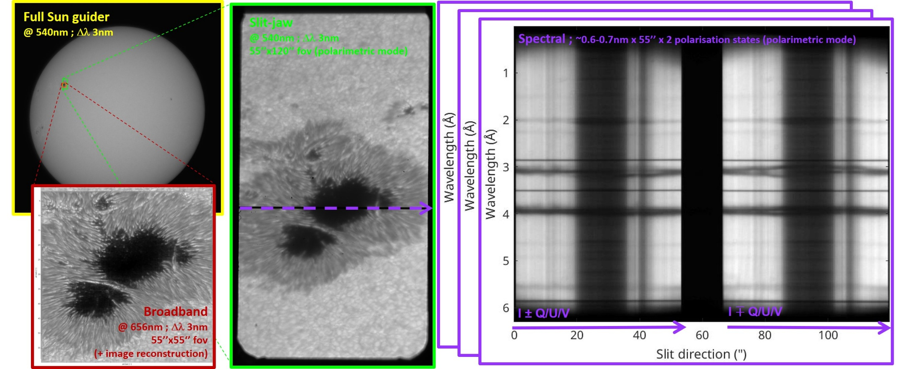
THEMIS data products
Full Sun Guider & spectrograph Slit-jaw context images
BroadBand images (BBI)
Main science product: MTR2 spectrograph spectral images

Slide 10
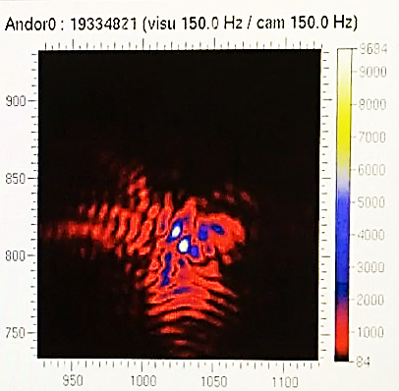
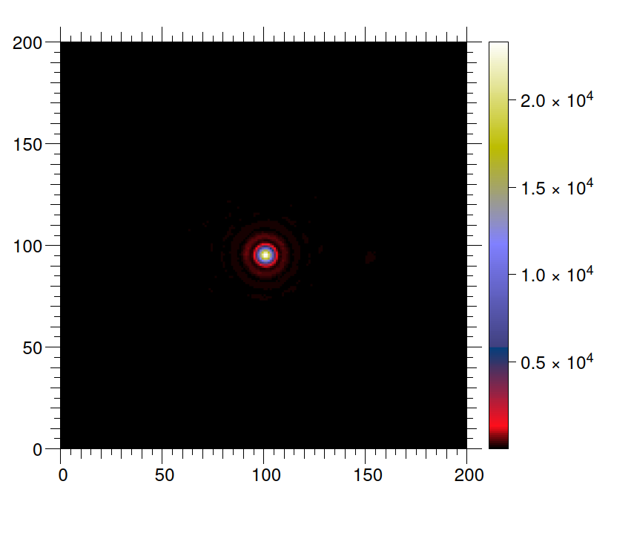
THEMIS Adaptive Optics (TAO): specifications & objectives
Specifications
76 sub-aperture Shack-Hartmann wavefront sensor (10×10);
380×380 pixel WFS images, Mikrotron EoSens 4CXP detector;
THEMIS-optical-path-compatible 16 mm deformable mirror
97 actuator on deformable mirror (11×11), from ALPAO
Real time correction (RTC)
Computer: CPU i7-4790K (Q2’14) at 4.2 GHz, 4 cores, up to 50 Gflops/core with AVX2 + FMA instructions.
Objectives
✓ Closed AO loop on the Sun
started from scratch mid-2016 → operative in December 2020
✓ RTC software running in CPU @1250 Hz (no GPU)
flexible RTC software to implement and experiment new algorithms
Next objective: unsupervised AO system (optimal correction whatever the conditions)
Thiebaut, E., Tallon, M. et al, SPIE proceedings 2022

Slide 11
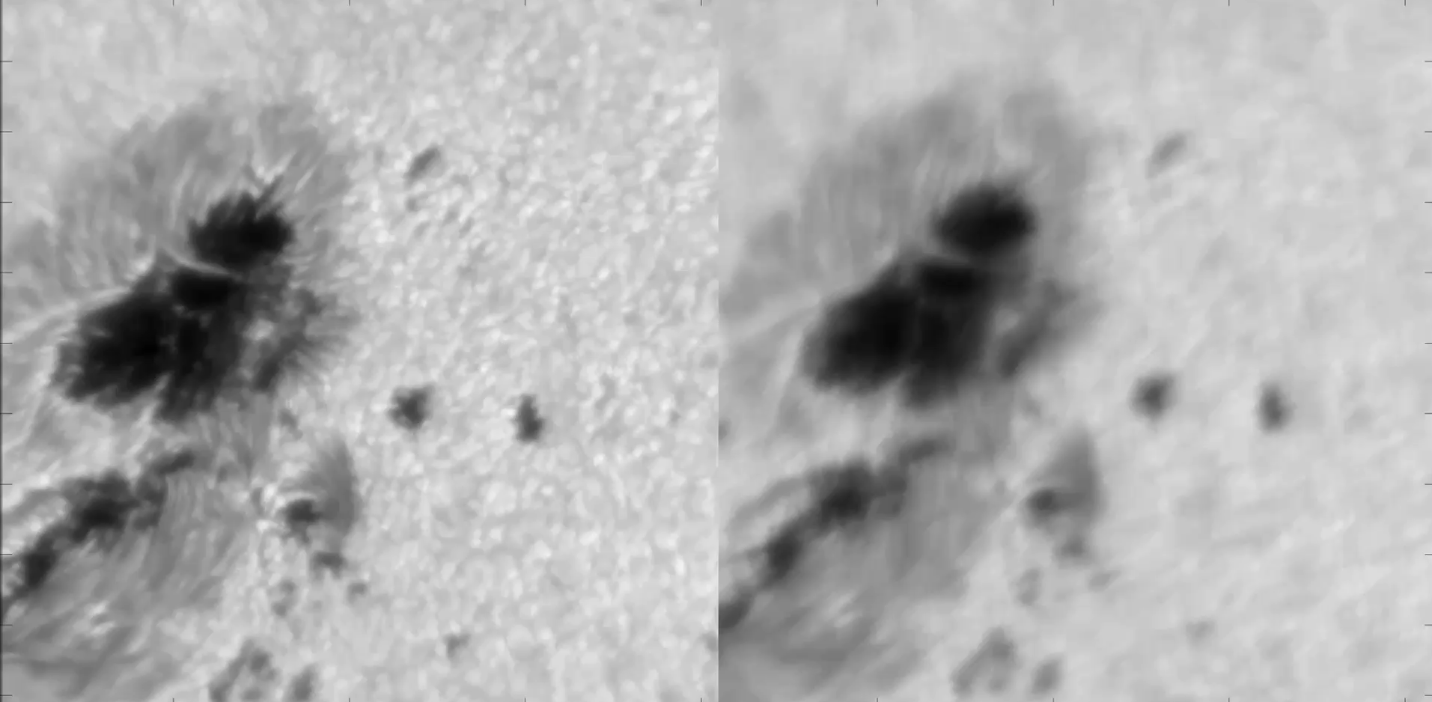
TAO going live on NOAA 12975
Successive recordings in equivalent seeing conditions
55’’ square field, 20 image/s (0.3 ms), 2k x 2k (0.03’’ /px) on Broadband Imaging Camera

Slide 12
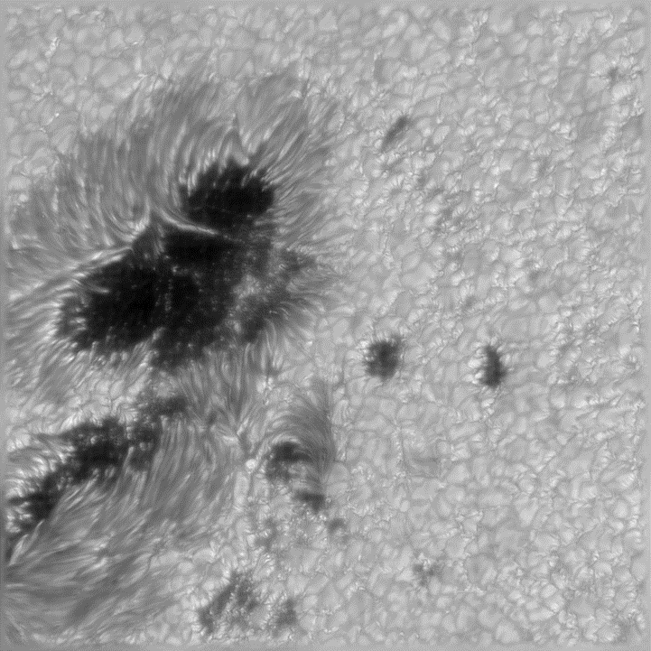
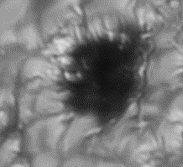
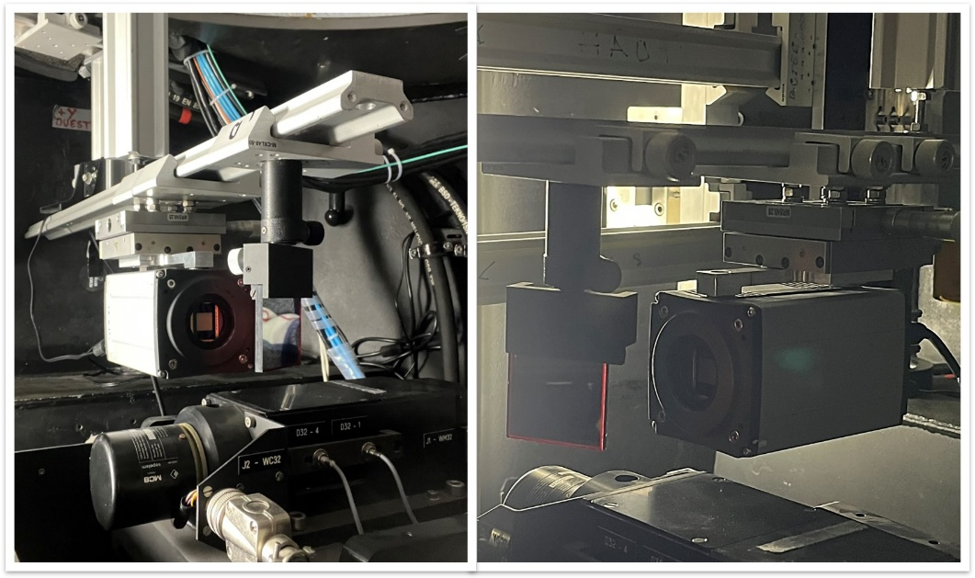
THEMIS at diffraction limit: NOAA 12975
THEMIS Broadband Imaging (BBI)
NOAA 12975 on 2022/03/31
Observed @ 630nm ; 1nm broadband red filter
55”x55” FOV
100 BBI acquisition @ 40 images/s
Knox-Thompson image post processing
➔ 0.17’’ resolution (0.035”/pixel) near THEMIS theoretical diffraction limit of 0.15”

Slide 13
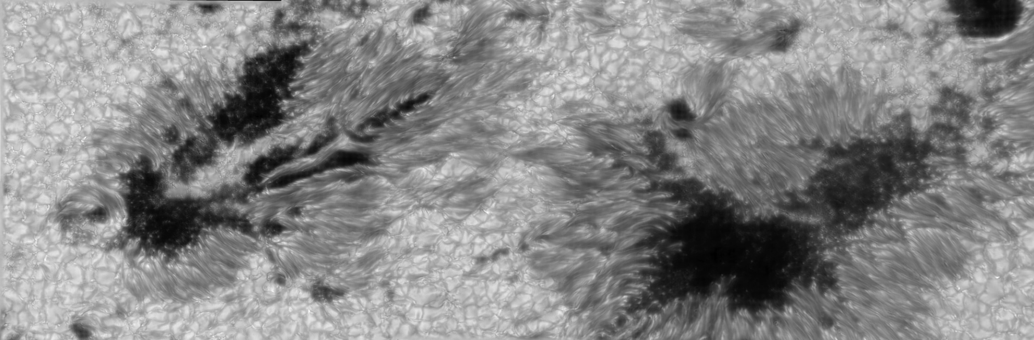
THEMIS at diffraction limit: NOAA 13354
NOAA 13354 on 2023/06/28 ; good seeing
150”x50” composite FOV
0.17’’ resolution (0.035”/pixel) near diffraction limit
Observed @ 630nm with 1nm broadband red filter
Several 55”x55” FOV acquisition by BBI camera in burst mode (40 images/s) + image restoration from residual seeing ➔ Routine operation with pipeline !
Images stitched together with Hugin software

Slide 14
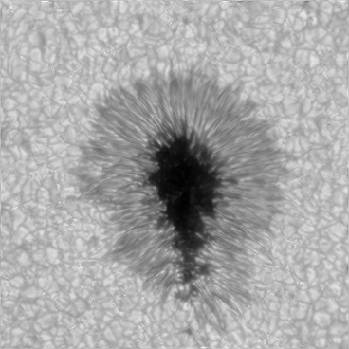
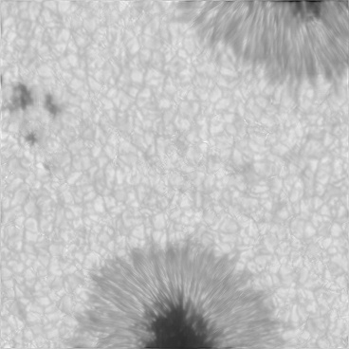
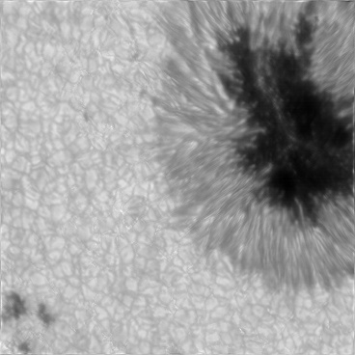
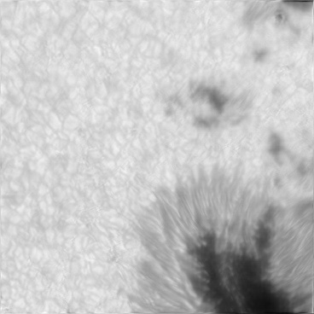
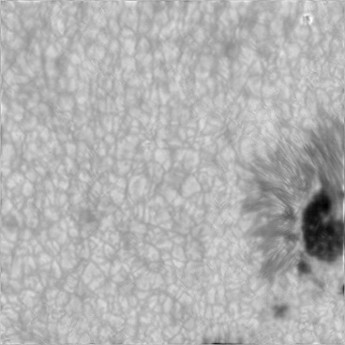
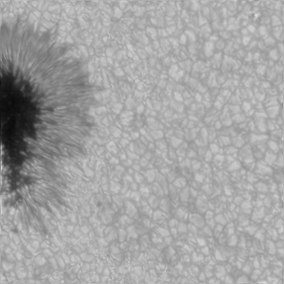
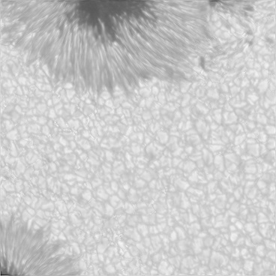
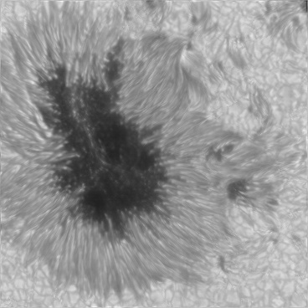
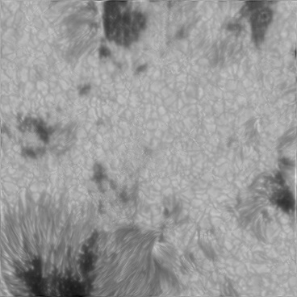
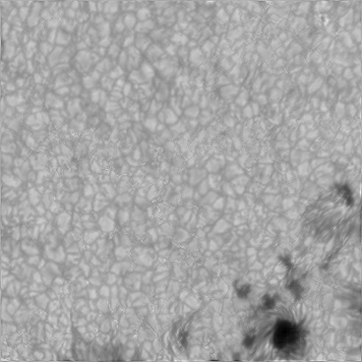
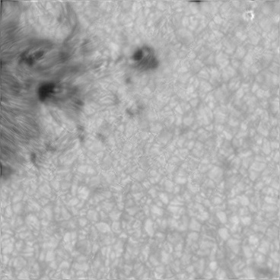
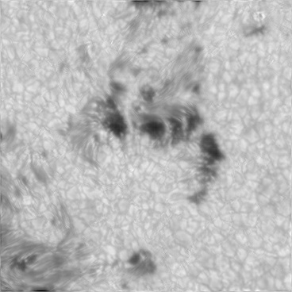
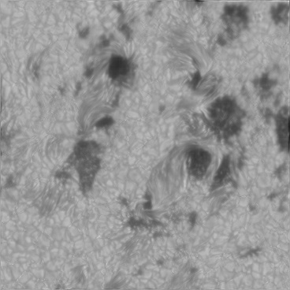
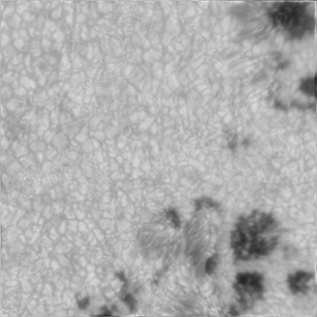
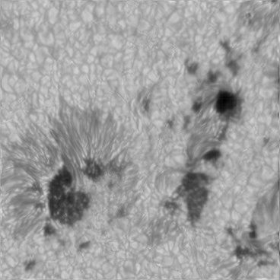
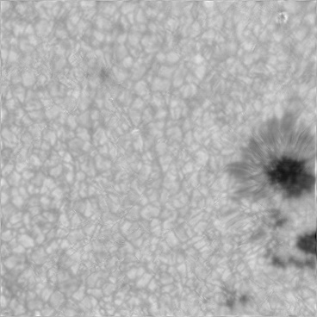
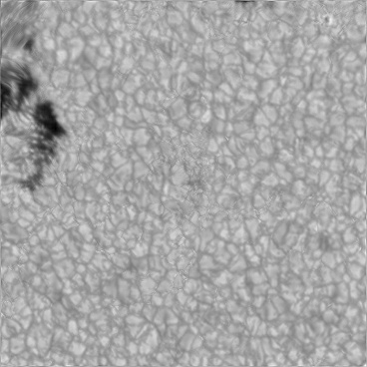
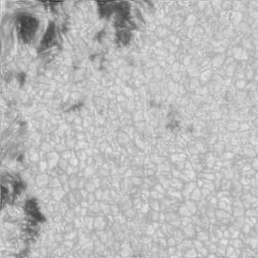
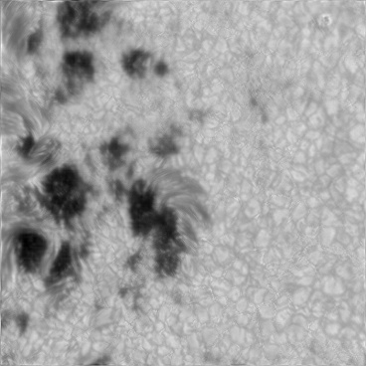
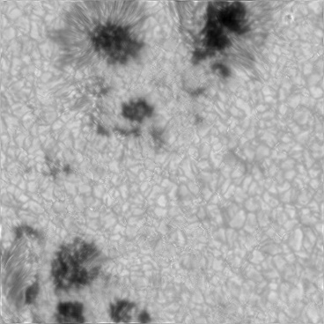
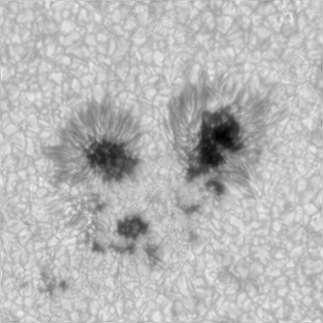
THEMIS large FOV reconstruction: NOAA 14114
Acquisition of sequential 21 BBI bursts (55x55” FOV) of NOAA 14114

Slide 15
~250”x140” composite FOV
Average seeing conditions
Spatial resolution: ~0.2”
Spatial resolution: ~1”

Slide 16
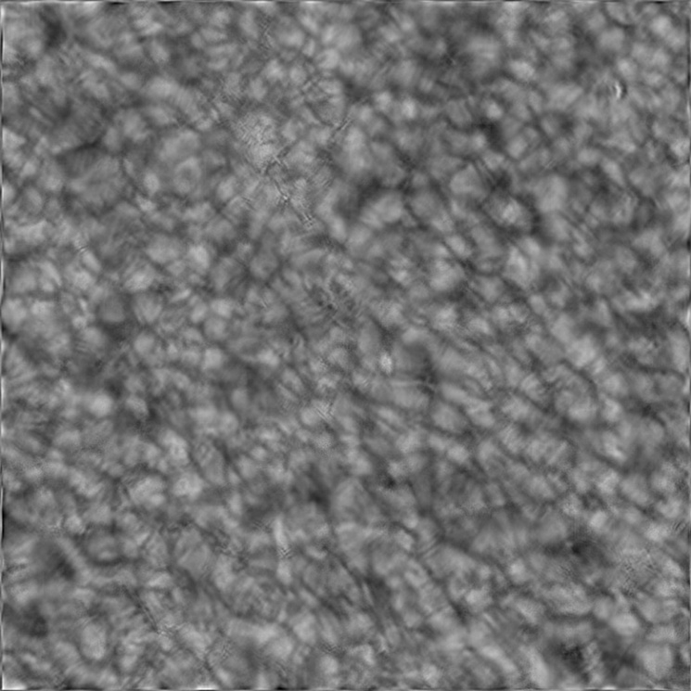
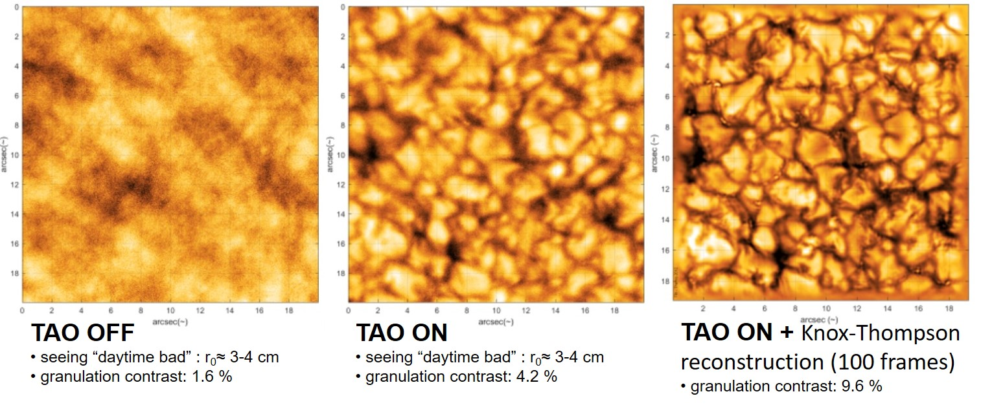
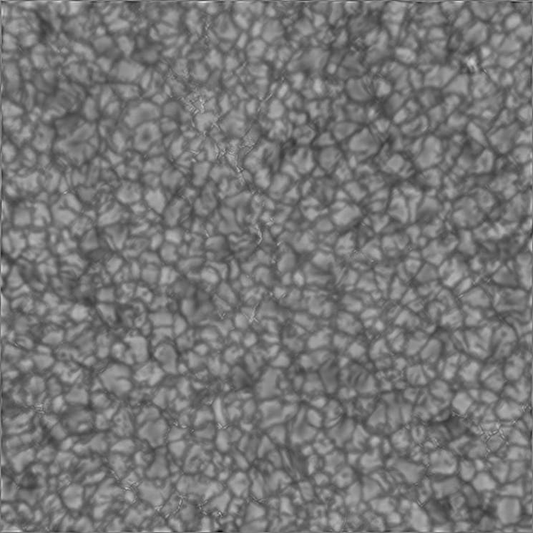
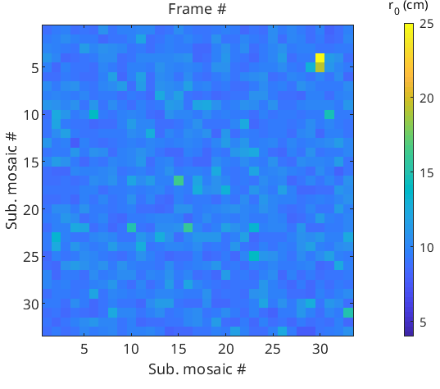
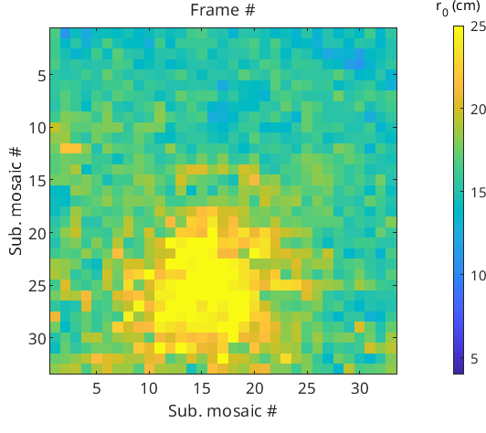
THEMIS Adaptive Optics (TAO): results on granulation
TAO Off
TAO on
TAO permits significant gain:
in effective seeing: e.g. Fried's coherence length from ~7cm (medium seeing) to ~25cm at TAO focus & ~17cm on rest of FOV
in granulation contrast

Slide 17
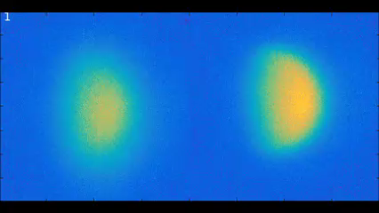
THEMIS Adaptive Optics (TAO): results on Mercury
Themis is one of the best-suited telescope for ground based observation of Mercury.
Work in daytime → extended period of observation of Mercury
Handle the low contrast of hermian emission relatively to the diffuse sky emission.
TAO successfully running for Mercury observations since 2021
Hardware and software identical to solar obs.
Requires slowing down AO from 1kHz to 150Hz
Sub-arcsecond mapping of Mercury sodium exospheric emission
Study hourly dynamics of Na emission distribution in regards of space weather acting on Mercury
Image Courtesy: Mangano, Leblanc

Slide 18
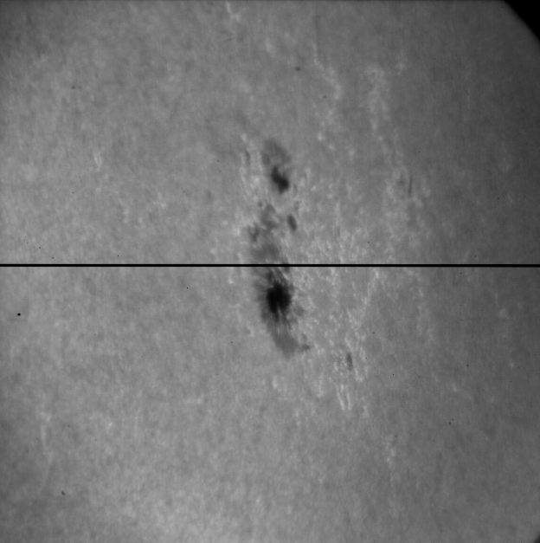
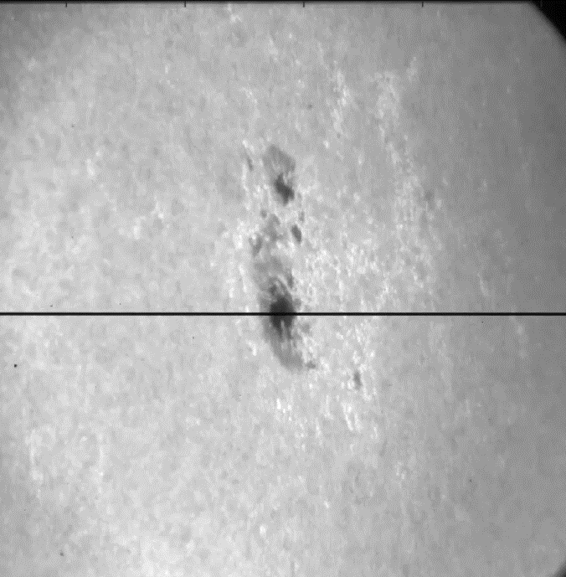

TAO for spectroscopy
Main strength and raison-d’être of THEMIS is spectropolarimetry!
Requires scans of the region of interest by the spectrograph slit:
Scan duration of a 90” domain
- with 0.3” steps &
- 0.1 s spectral camera acquisition time
3 min without polarimetry
25 min with polarimetry
Spectroscopic measurement requires that TAO must hold and stabilize wavefront over FOV during extended periods of time.

Slide 19




TAO for spectroscopy
Spectroscopic measurement requires that TAO must hold and stabilize wavefront over FOV during extended periods of time.
Challenging
Isoplanatic patch away from spectrograph slit in long scan
Stable seeing over extended period of time remains needed
TAO off
TAO on
10:31-10:34 UT
10:38-10:41 UT
TAO on
TAO on
not holding
Spatial res.: ~1”
SDO/HMI continuum
25/06/16
10:45 UT
10:51-10:55 UT

Slide 20

TAO for spectroscopy: good seeing conditions

Slide 21




TAO for spectroscopy: good seeing conditions
TAO stabilization can hold over several scans
2-3 Hα reconstructed images of solar filaments + image stitching
2025 Observations campaign of B. Schmieder

Slide 22



TAO for spectro-polarimetry
TAO can also give good results on long spectropolarimetric scans
THEMIS goals : B maps with spatial resolution better than 0.5” arcsec
3 times better than before
equivalent to HINODE results
AO off
AO on
I
Q/I
AO on
U/I
V/I

Slide 23












THEMIS new polarimetric analysis scheme - 1
Full-Stokes analyzer (An4) located at the F1 prime focus, delivering dual-beam polarimetry with beam exchange.
Dual-beam (single Savart plate)
$${ S}_{+Q}=\left[\begin{matrix} I \\ +Q \\ \begin{aligned}0 \\ 0\end{aligned}\end{matrix}\right]$$
$${ S}_{−Q}=\left[\begin{matrix} I \\ −Q \\ \begin{aligned}0 \\ 0\end{aligned}\end{matrix}\right]$$
“Beam Splitter”
Input
modulation (QW)
$$S=\left[\begin{matrix}I \\ Q \\ \begin{aligned}U \\ V\end{aligned}\end{matrix}\right]$$
$$S_{V}=\left[\begin{matrix}I \\ V \\ \begin{aligned}Q \\ U\end{aligned}\end{matrix}\right]$$
$$S_{Q}=\left[\begin{matrix}I \\ Q \\ \begin{aligned}U \\ V\end{aligned}\end{matrix}\right]$$
$$S_{U}=\left[\begin{matrix}I \\ U \\ \begin{aligned}V \\ Q\end{aligned}\end{matrix}\right]$$
$$S_{+V}=\left[\begin{matrix} I \\ +V \\ \begin{aligned}0 \\ 0\end{aligned}\end{matrix}\right]$$
$$S_{−V}=\left[\begin{matrix} I \\ −V \\ \begin{aligned}0 \\ 0\end{aligned}\end{matrix}\right]$$
Double Savart plates:
generate the dual beam feature
then superimpose both beams: behave as one, differing only by their linear polarization state.
$$S_{+U}=\left[\begin{matrix} I \\ +U \\ \begin{aligned}0 \\ 0\end{aligned}\end{matrix}\right]$$
$$S_{−U}=\left[\begin{matrix} I \\ −U \\ \begin{aligned}0 \\ 0\end{aligned}\end{matrix}\right]$$
Beam exchange
“DSBS”

Slide 24


THEMIS new polarimetric analysis scheme - 2
Thanks to THEMIS “polarization friendly” new optical path (geometry of the elevation axis, field rotator, coatings), polarizer output can travel through the telescope and reach the spectrograph cameras “minimally perturbed”
Just in front of each of the spectral cameras, a Wollaston prism splitter separates the superimposed beam into complementary Stokes components to form the spectral focal plane.

Slide 25


THEMIS Mueller matrix@~600nm
THEMIS Mueller matrix:
$$M_{THEMIS}=\left(\begin{matrix} 1.000 & −0.009 & −0.003 & 0.001 \\ −0.008 & 0.885 & 0.016 & −0.033 \\ 0.014 & −0.436 & 0.872 & 0.033 \\ −0.019 & 0.415 & 0.008 & 0.873\end{matrix}\right)$$
Averaged over one full day
Includes changing elevation axis and field derotation
Quite constant along one day
THEMIS remains a strongly polarization-calibration-free telescope, ideal for excellent spectropolarimetric measurements.

Slide 26



Stokes parameters
Complete polarization signal is now routinely outputted
4D data array of 4 Stokes parameter (x, y, λ, S).
User-friendly software in development.
THEMIS is on the verge of producing vector B maps
I
Q/I
In Fe I Line
In continuum
I
Q/I
U/I
V/I
No polarization signal
U/I
V/I
NOAA 14100 ; 29/05/2025 10:30-10:50 UT

Slide 27


In consideration: THEMIS for space weather
Research for space weather is a strength of the French heliophysics community
THEMIS shall eventually be out passed by 4m-class telescope (DKIST, EST)
THEMIS is the main French-owned asset that can provide B field maps
Presently, high-dependence on NASA SDO/HMI for vector magnetic field measurements of EU community
THEMIS is presently an INSU observation station (ANO-3)
Mutualization of several solar-related SNOs in consideration at ATST & INSU toward space weathers
Reflection toward part usage of THEMIS in service mode with the production of datasets of interest for SW: magnetic map of eruptive regions (active regions, filaments, …)
Fe I
Q/I
Hα
V/I

Slide 28



Upcoming : IBIS 2.0 to THEMIS
IBIS : Interferometric BIdimensional Spectrometer
INAF solar spectro-imager $\left(x,y,λ\right),$ dual Fabry-Perot / 200 000 spectral res. / short exposure times / polarimetric mode
Running at the Dunn solar tower (DST) from 2003 to 2019: ~100 papers based on IBIS over 15 years
IBIS2.0 @THEMIS
Upgraded IBIS waiting for suitable telescope since 2019
TAO performance attractive for IBIS
THEMIS has no equivalent instrumental mode. Memorandum of understanding (MOU) signed !
Winter 2025-2026 : IBIS 2.0 installation and commissioning.
Intensity, magnetic field strength, field inclination angle, and LOS velocities on 2012 May 28 (14:00-14:30 UT): before (top) and after (bottom) penumbra formation. SIR inversion of the Stokes profiles of the Fe I 630.25 nm line acquired by IBIS. (from Murabito et al. 2016)
Outstanding synergic complement of THEMIS long slit spectrograph
High scientific return for a limited technical investment
Foster and renew French-Italian scientific collaboration in high-res. solar phys.
THEMIS offers IBIS2.0 a chance at planetary observations with AO.

Slide 29




Outreach
New THEMIS website:
Please provide feedbacks
New Instagram account
Follow us @themis_solar
Downloadable posters on THEMIS highlights (soon)
https://www.themis.iac.es/

Slide 30


Takeaways ...
THEMIS is a competitive 21st century telescope with unprecedented capacities
THEMIS is a real challenger in the 1m-1.5m class of solar telescopes.
Installation of the IBIS 2.0 spectro-imager (winter 2025-26) will trigger an even larger European wide interest.
Reminder: 50-75% of THEMIS obs. time dedicated to French-lab.-based PIs
THEMIS is highly open to all scientists based in a French laboratory
Observation at THEMIS is not reserved to an elite of high-resolution spectro-polarimetry expert !
The THEMIS team is dedicated to assist anyone in performing observations with THEMIS
Young-researchers at French laboratories are highly welcomed to discover/run/follow ground-based solar observations campaigns

Slide 31



… critical threats exits …
20/08/2023 - Tenerife
Absence of redundancy in technical expertise
23/09/2021 – La Palma
Volcanic eruptions
Mega-fires

Slide 32


… and nevertheless !
THEMIS IS NOT the future of ground-based solar physics because
the European Solar Telescope
IS THIS FUTURE !
White paper on interest, contribution & participation of the French community to the EST project is being written:
JOIN NOW !

Slide 34


TAO linearized model of wavefront sensor data and DM commands in the THEMIS system
Actual
wavefront
Actuator
commands
… some noise
$G=S . M$ is the interaction matrix
$y_{t}=d_{t} −G.a_{t}$ are $≈$open loop data
$μ_{t}>0$ and $W ≈Cov\left(w_{t}\right)$ are loop parameters to enforce spatial regularization
$ρ_{t}>0$ is a loop parameter to impose temporal continuity
WFS data
$$d_{t}=S.\left(w_{t}+M.a_{t}\right)+z_{t }$$
Sensor linear response
Mirror influence matrix
Wavefront is represented in the basis of influence functions of the DM
No predictions in TAO v.2 (but will appear in TAO v.3)
$$a_{t+δt}=argmin\{{ \left\|y_{t}+G . a\right\|}_{{Cov\left(z_{t}\right)}^{−1}}^{2}+μ_{t}{\left|\left|a\right|\right|}_{W}^{2}+ρ_{t}{\left|\left|a−a_{t}\right|\right|}^{2} \}$$
$→$ Requires to solve an inverse problem (argmin…) at each step (all terms may change with time)
Thiebaut, E., Tallon, M. et al, SPIE proceedings 2022

Slide 35







Example of a “polarization friendly” field rotator
BAD (really bad …)
Made of 3 mirrors with incidence = 55º / 20° / 55°
chromatic retardance is enormous (60°)
MUCH BETTER !!
Rotator, composed of 2 prisms and one mirror incidence=45º /45°/ 10° / 45° /45°
Retardance cancellation of the crossed prisms@100° (zero retardance for 90° only)
Coating required on prisms hypothenuse

