Slide 1



A new era for the
THEMIS Solar Telescope
FSLAC
International
Research Lab.
Jan 15th 2026, Freiburg, Germany
Étienne Pariat^{1, 2}, Bernard Gelly¹ & THEMIS team
¹ French-Spanish Laboratory for Astrophysics in Canarias (FSLAC) / IAC & CNRS IRL2009, Tenerife, ES
² LPP, Sorbonne Université, Ecole polytechnique, Institut Polytechnique de Paris,
UPS, Observatoire de Paris-PSL, CNRS, Paris, FR
Methods and techniques for high-resolution spectro-polarimetry with current and future high-resolution telescopes:
lessons learned and ways forward

Slide 2
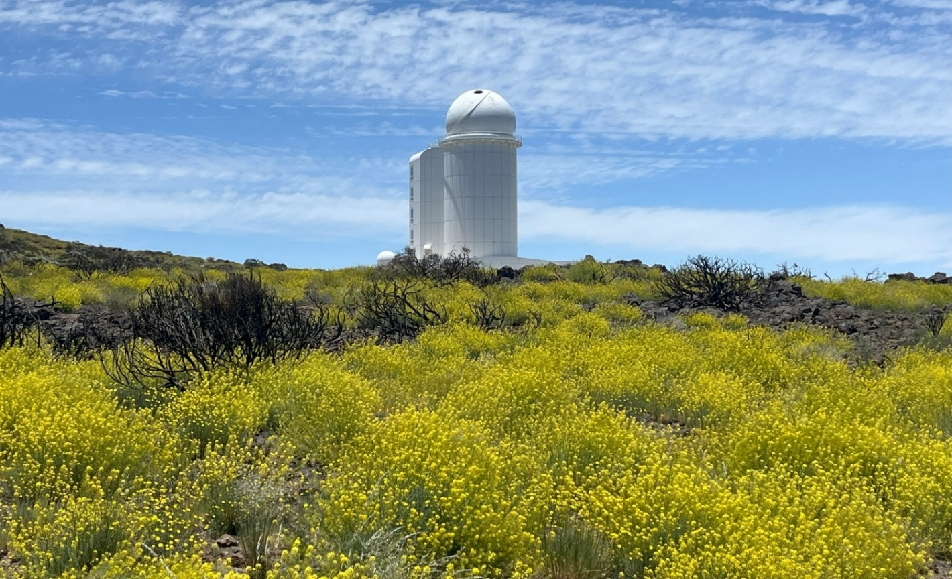
THEMIS Factsheet
Very well-maintained but,
be that at it may,
a pre-AO 20th century instrument !
Main french solar telescope
  Designed by J. Rayrole, P. Mein & M. Semel
  Located at Teide Observatory, Tenerife, Spain
  1st light in March 1996, & commissioned in 1999
1m-class solar telescope, with one the world “slowest” optical design:
  Aperture: 92 cm ; Effective focal length: 57m
  Effective focal ratio: f/62
  60”x60” to 120”’x120” square field-of-view
MulTi Ray spectrograph (MTR2): ideal for high-spectral resolution spectropolarimetry:
  Working spectral range: 4000 - 11000 Å
  Polarization calibration free
  Ultra-high spectral resolving power:
    R ~ 200 000 - 300 000
  Simultaneous observations of user-defined set of up to 6 spectral ranges:
    ~6-7 Å spec. range width with ~25 mÅ res.
THEMIS @ OT in June 2025

Slide 3
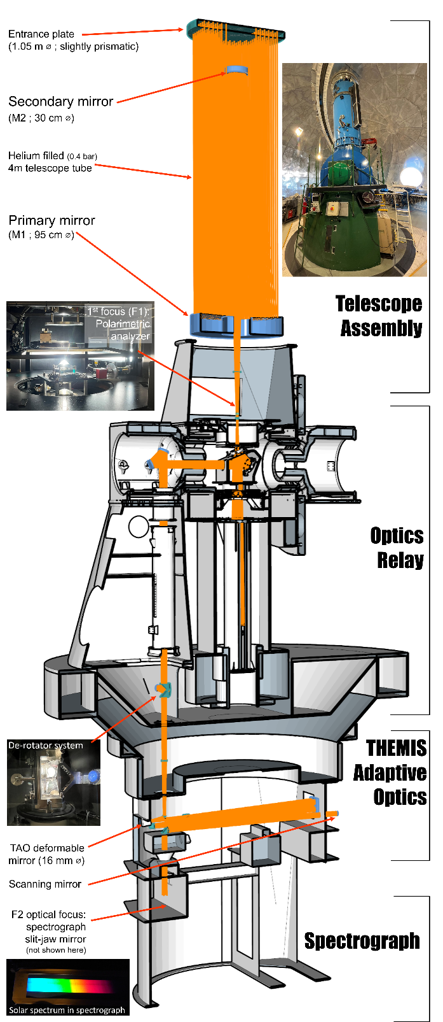
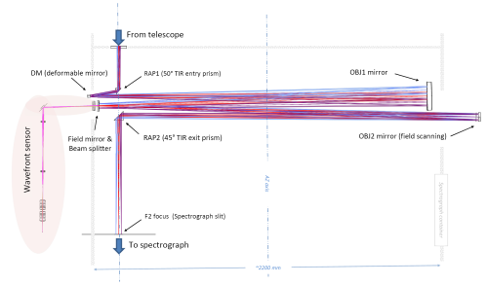
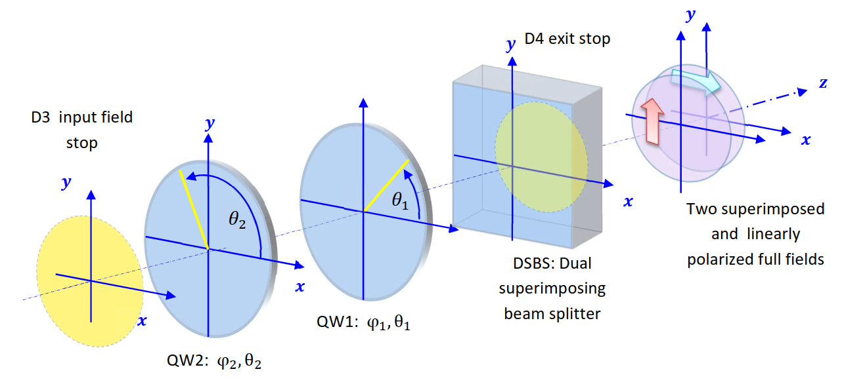
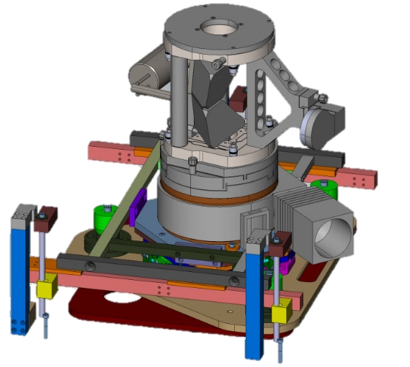
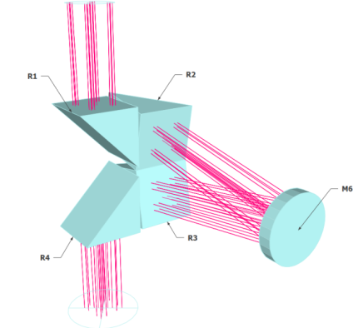
“Total makeover” : 2016 → 2020
THEMIS has been widely renewed and redesigned
  Thanks to EU funding: ~1M€ from 2 IAC-led SOLARNET programs
M2 mirror re-aluminising (WHT & THEMIS)
Themis Adaptive Optics: “classical” single-DM adaptive optics based on innovative wavefront sensing and mirror commanding concepts (AIRI@CRAL & THEMIS)
Superimposed dual-beam polarimetric analysis without field limitation (Semel M., Lopez A., Le Men C. & THEMIS)
“Polarization- friendly” complete redesign of the whole transfer optics (M3, M4 & M5) (Le Men, C. & THEMIS)
New de-rotator system (THEMIS)
+ new context, broadband and spectral cameras.

Slide 4

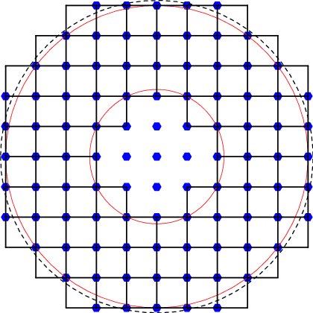
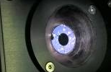
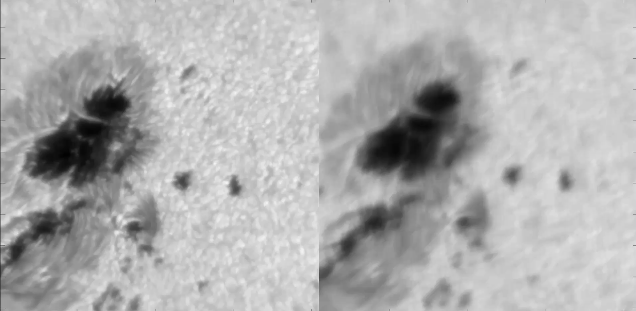
THEMIS Adaptive Optics (TAO)
Specifications
  76 sub-aperture Shack-Hartmann WFS
    380×380 pixel WFS images, Mikrotron EoSens 4CXP detector
  THEMIS-optical-path-compatible 16mm DM
  97 actuators on ALPAO deformable mirror
  Real time correction (RTC)
    Computer: CPU i7-4790K (Q2’14) at 4.2 GHz, 4 cores, up to 50 Gflops/core with AVX2 + FMA instructions.
Objectives:
  ✓ Closed AO loop on the Sun
    started from scratch mid-2016 → Dec. 2020
  ✓ RTC software running in CPU @1250 Hz
  Ongoing (→ winter 2025-2026): unsupervised AO system
    optimal correction whatever the conditions
    provide inferred seeing conditions
TAO geometry with a combination of DM/wavefront sensor set up in 'Fried configuration' with a spacing number of 10
NOAA 12975 on 2022/03/31

Slide 5
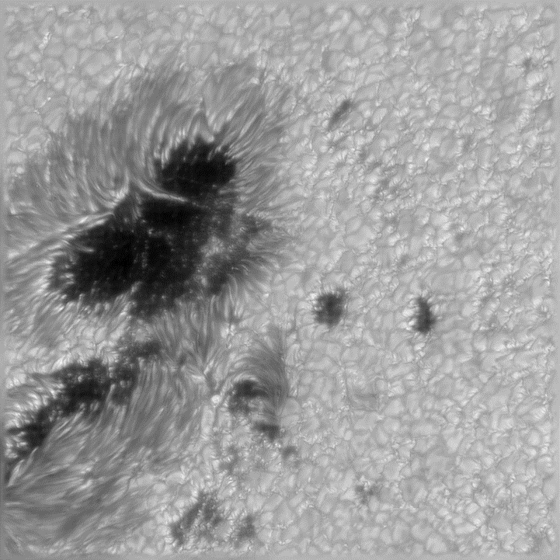
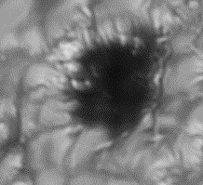
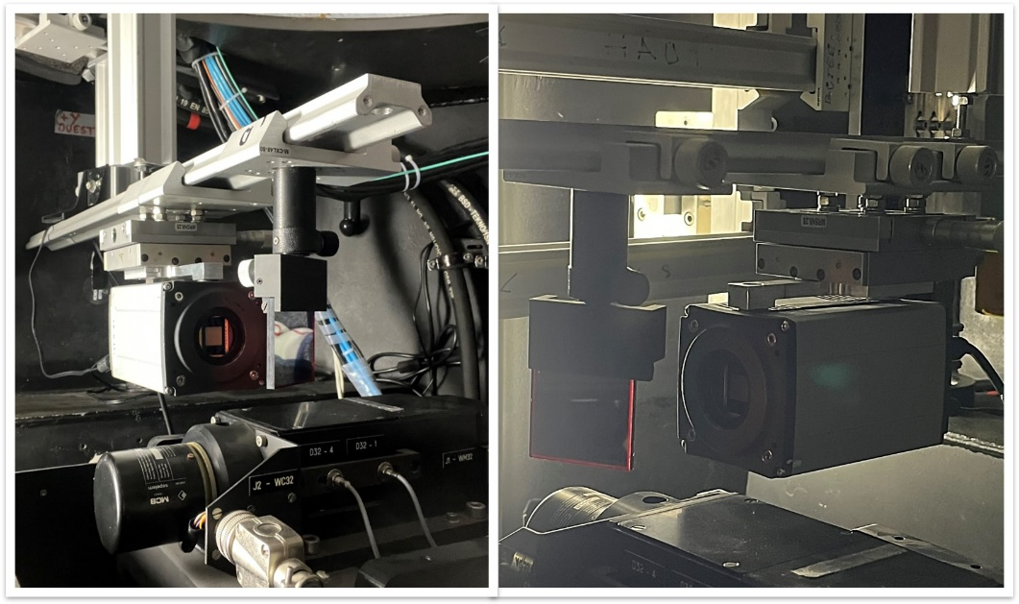
THEMIS at diffraction limit: NOAA 12975
THEMIS Broadband Imaging (BBI)
NOAA 12975 on 2022/03/31
Observed @ ~630nm ; 1nm broadband red filter
55”x55” FOV
100 BBI acquisition @ 40 images/s
Knox-Thompson (speckle) image post processing
➔ 0.17’’ resolution (0.035”/pixel) near THEMIS theoretical diffraction limit of 0.15”

Slide 6
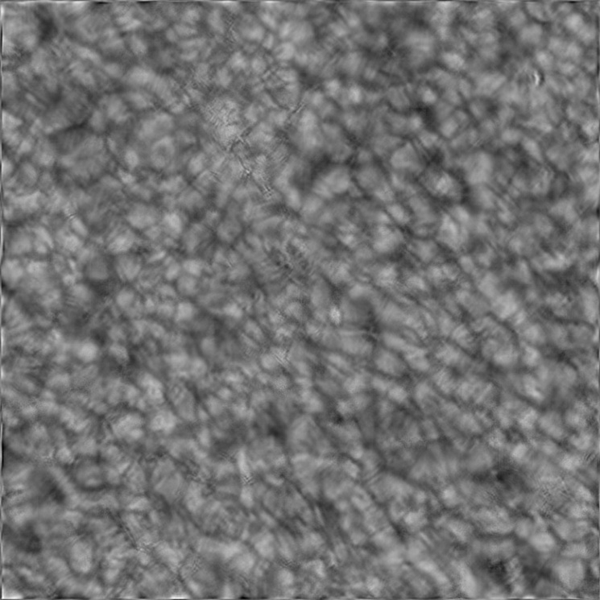
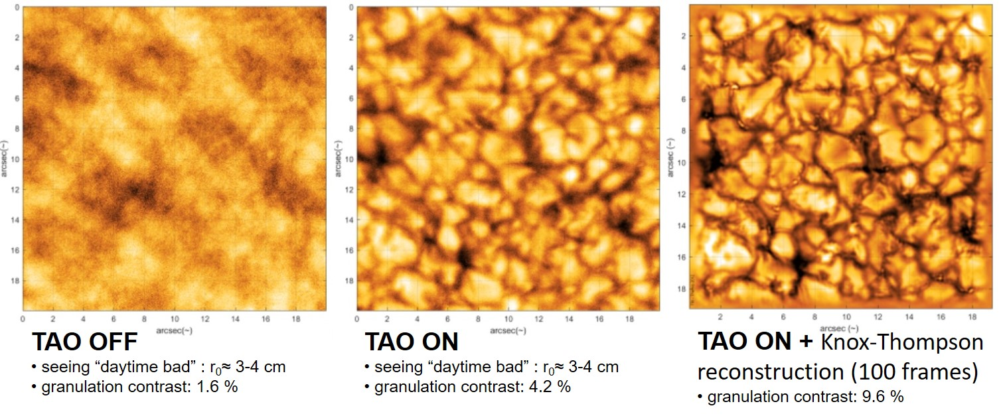
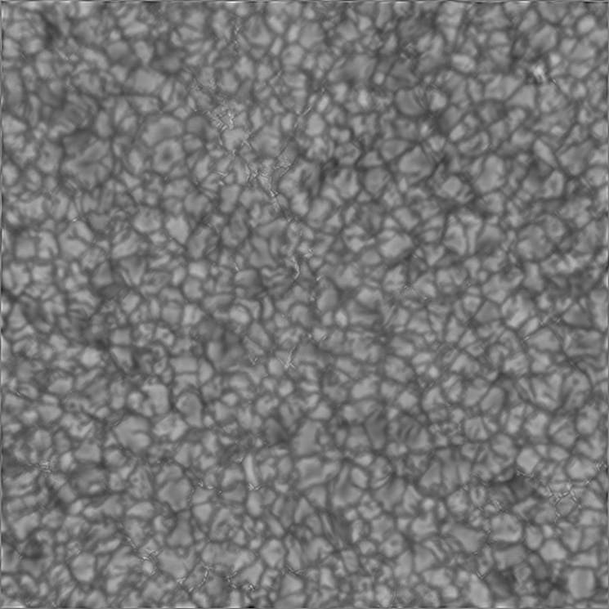
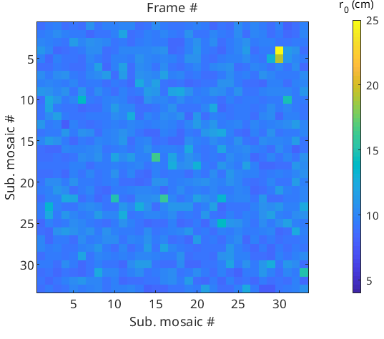
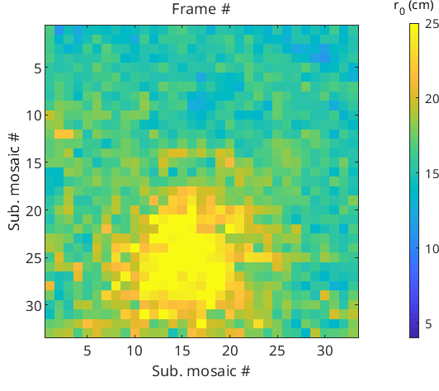
THEMIS Adaptive Optics (TAO): results on granulation
TAO Off
TAO on
r₀ distribution
TAO permits significant quantitative image quality gain:
  in effective seeing: Fried's coherence length from r₀~7cm (ave. seeing)
    ~25cm at TAO focus
    ~17cm on rest of FOV, away from isoplanatic patch
  in granulation contrast: from ~1-2% (bad seeing)
    to ~10% (with image reconstruction)

Slide 7
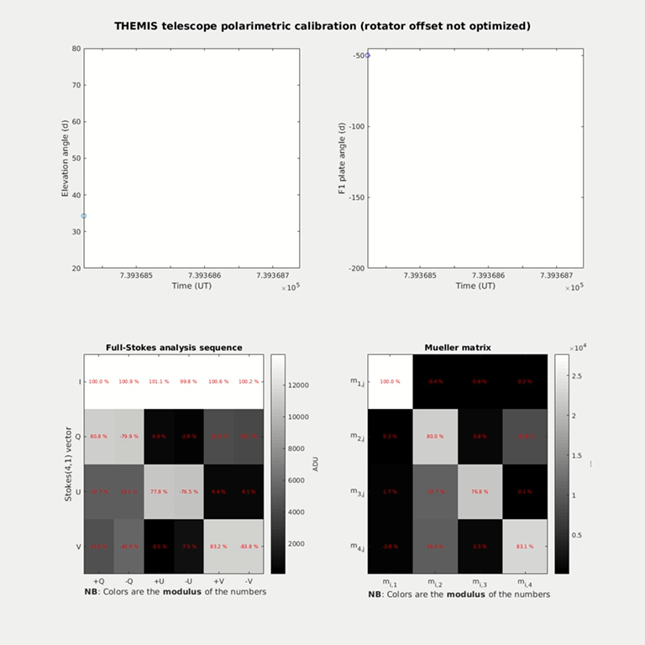
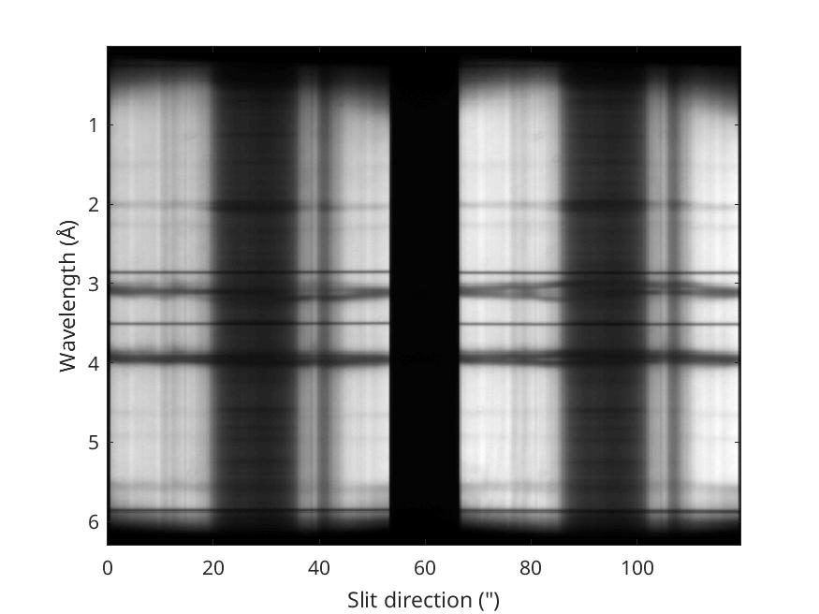
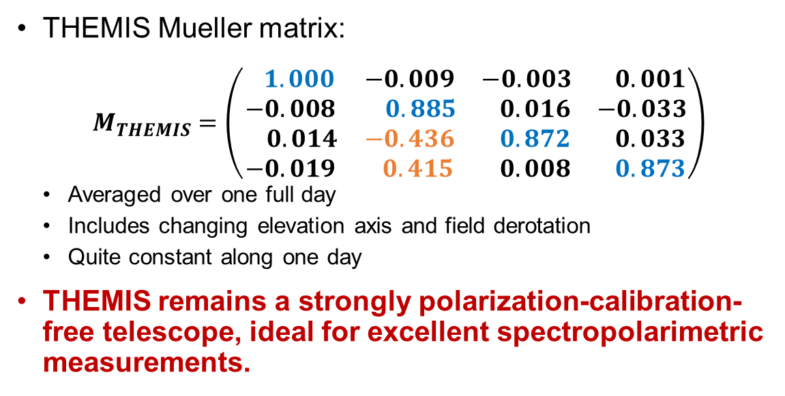
THEMIS polarization analysis
New “polarization friendly” AO-compatible optical path:
  Polarization units + double Savart plates @ F1 ➔ dual-beam with beam exchange.
  Wollaston prisms in front of spectral cameras: ➔ complementary Stokes on camera FOV
THEMIS Mueller matrix:
$$M_{THEMIS}=\left(\begin{matrix} 1.000 & −0.009 & −0.003 & 0.001 \\ −0.008 & 0.885 & 0.016 & −0.033 \\ 0.014 & −0.436 & 0.872 & 0.033 \\ −0.019 & 0.415 & 0.008 & 0.873\end{matrix}\right)$$
  Averaged over one full day
  Includes changing elevation axis and field derotation
  Quite constant along one day
THEMIS remains a strongly polarization-calibration-free telescope, ideal for excellent spectropolarimetric measurements.

Slide 8
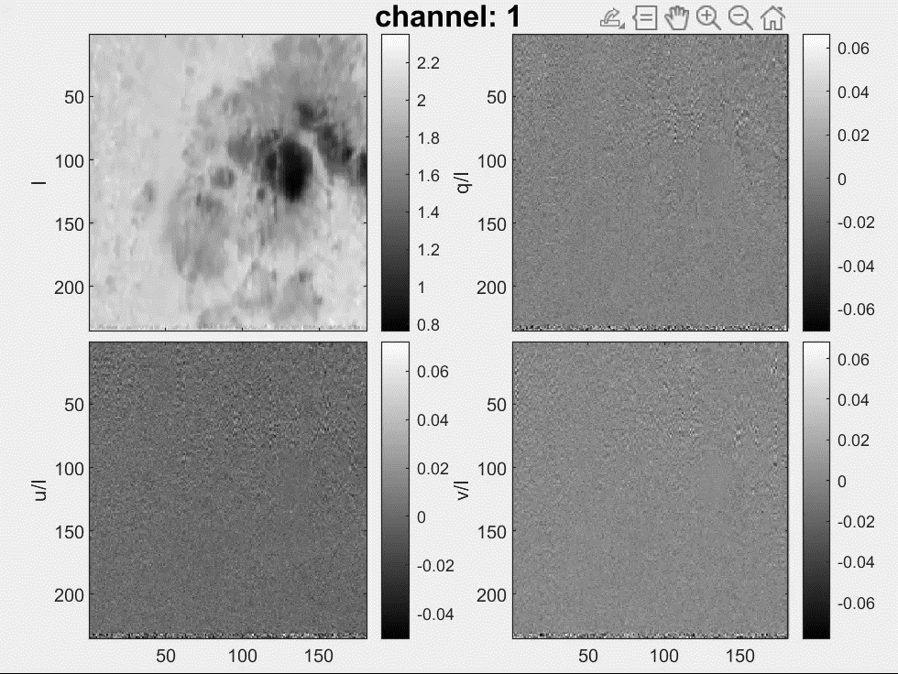
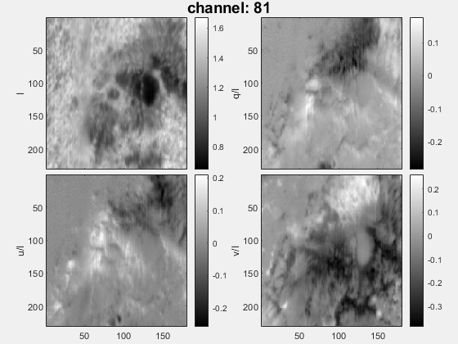
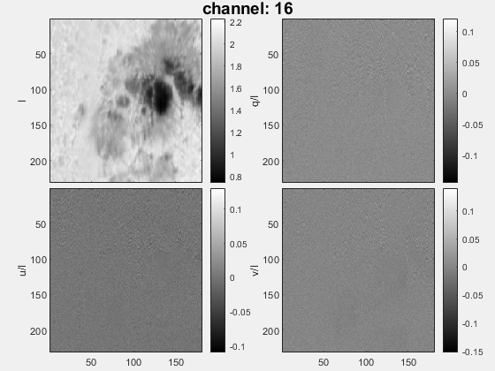
Stokes parameters maps
Stokes map datacube
256 λ channels after 2x rebinning
25mÅ /pixel spectral resolution
Complete polarization signal now routinely measured
  4D data array of 4 Stokes parameter (x, y, λ, S).
  User-friendly software in development.
THEMIS goals : B maps with spatial resolution < 0.5”
  x10 area resolution improvement
I
Q/I
Fe I Line center
Continuum
I
Q/I
U/I
V/I
U/I
V/I
No polar.
signal
NOAA 14100 ; 29/05/2025 10:30-10:50 UT

Slide 9

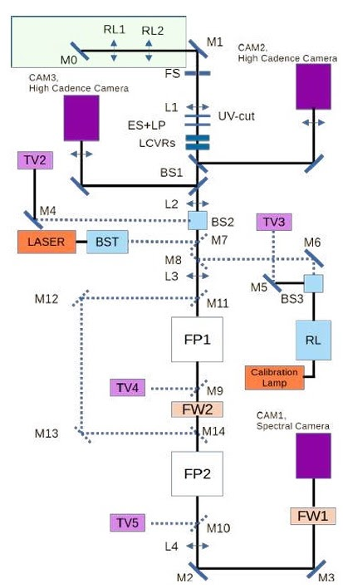
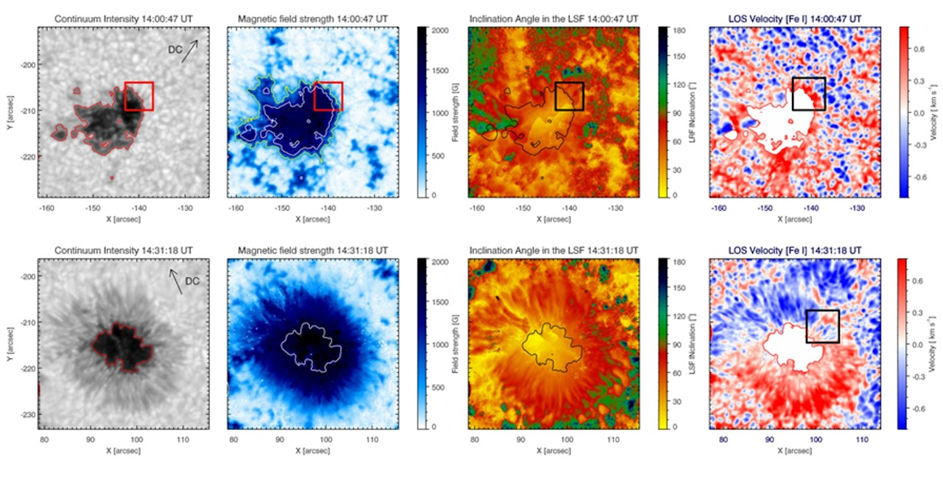
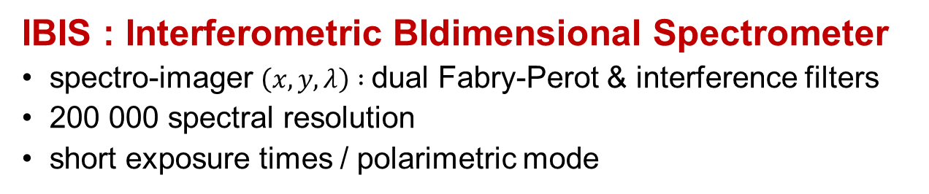
Upcoming : IBIS 2.0 @ THEMIS
IBIS : Interferometric BIdimensional Spectrometer
spectro-imager $\left(x,y,λ\right) :$dual Fabry-Perot & interference filters
200 000 spectral resolution
short exposure times / polarimetric mode
https://www.ibis20.inaf.it
Intensity, magnetic field strength, field inclination angle, and LOS velocities on 2012 May 28 (14:00-14:30 UT): before (top) and after (bottom) penumbra formation. SIR inversion of the Stokes profiles of the Fe I 630.25 nm line acquired by IBIS . (from Murabito et al. 2016)
Ermolli et al. 2024

Slide 10
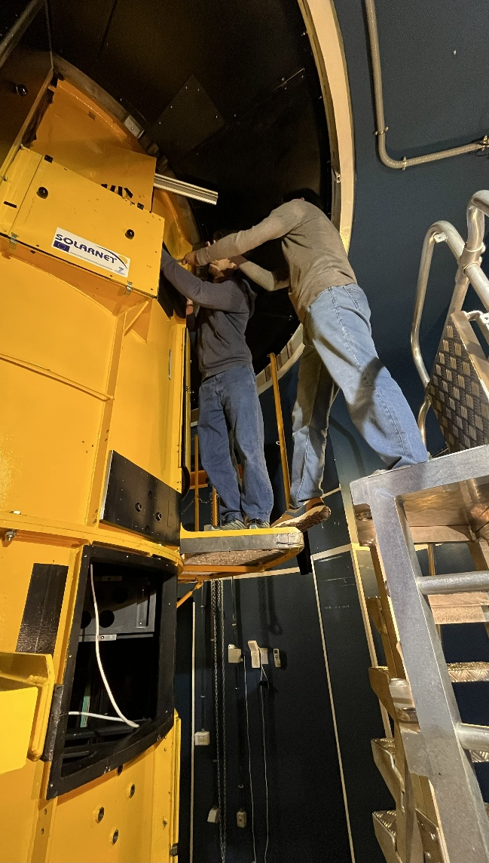
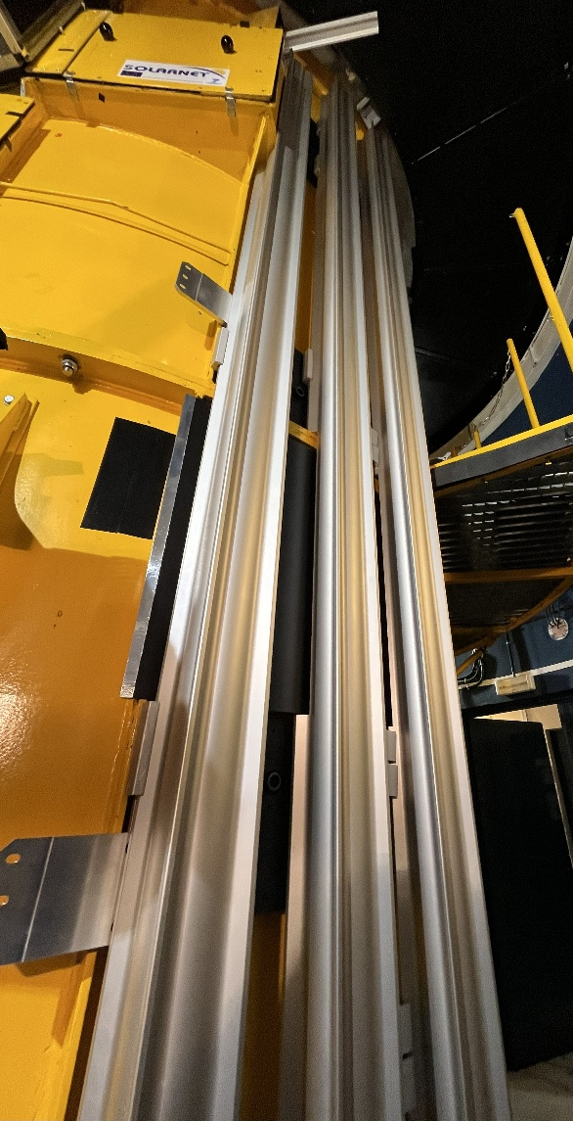
Upcoming : IBIS 2.0 to THEMIS
2003-2019: running at the Dunn solar tower (DST) ~100 papers based on IBIS over 15 years
Upgraded IBIS looking for suitable telescope since 2019
TAO performance attractive for IBIS
THEMIS has no equivalent instrumental mode
➔ Memorandum of Understanding signed between INAF and CNRS in winter 2024-2025
Nov. 25: preparatory installation of optical bench
Spring 2026 : IBIS 2.0 installation & commissioning.
IBIS2.0 is an outstanding synergic complement of THEMIS long slit spectrograph
Foster and renew French-Italian scientific collaboration in high-resolution solar physics, beneficial at large for EU solar physics (e.g. EST)
Nov. 2025

Slide 11
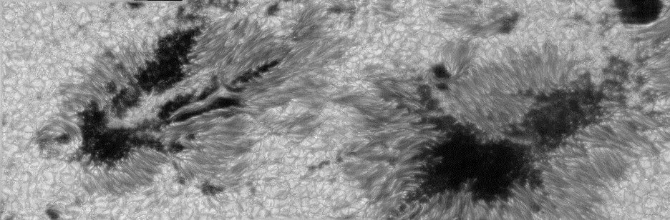
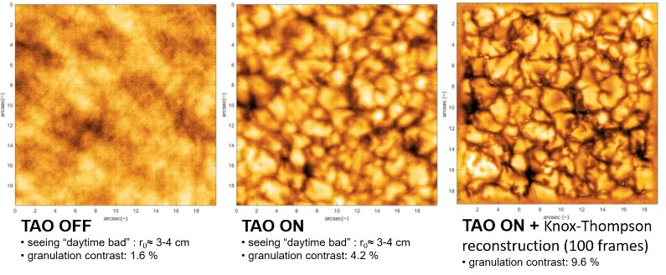
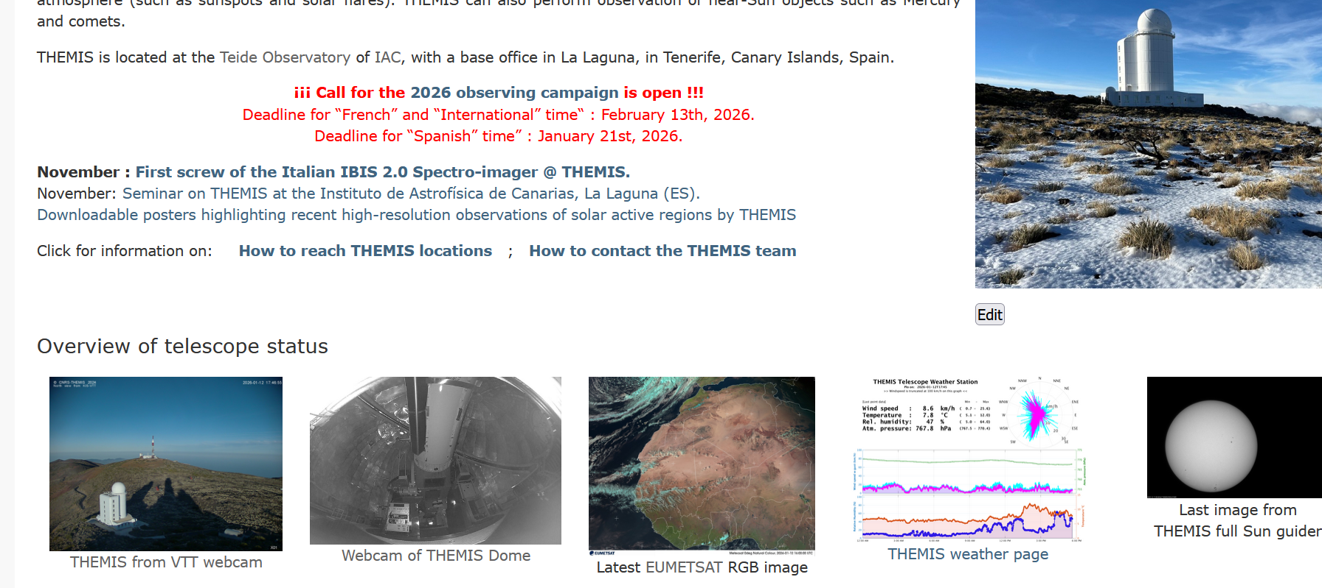

Takeaways
THEMIS is now a competitive 21st century telescope in the 1m-1.5m class with renewed spectropolarimetric capacities synergic with existing infrastructure
Installation of the IBIS 2.0 spectro-imager (spring 2026)
Funded science projects
  hiring of early career researchers (1 PhD, 2 Postdocs) + 1 operator
  shall strengthen French high res. solar phys. community
New outreach tools
  THEMIS website; Instagram account
Call for (reduced) 2026 campaign now open !
Fe I Line (630 nm)
I
Q/I
U/I
V/I
https://www.themis.iac.es/

Slide 13

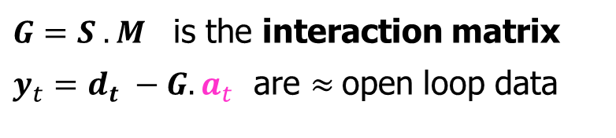
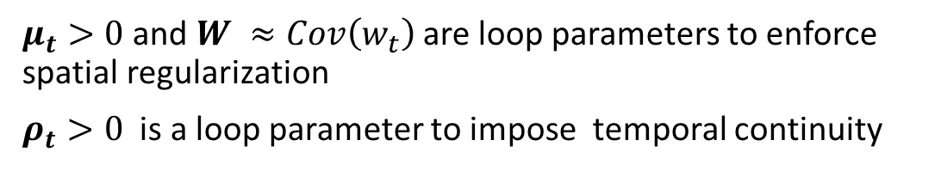
TAO linearized model of wavefront sensor data and
DM commands in the THEMIS system
Wavefront is represented in the basis of influence functions of the DM
➔ Requires to solve an inverse problem (argmin…) at each step (all terms may change with time), in real-time (~1kHz)
Actual
wavefront
Actuator
commands
… some noise
WFS data
$$d_{t}=S.\left(w_{t}+M.a_{t}\right)+z_{t }$$
Thiebaut, E., Tallon, M. et al, SPIE proceedings 2022
Sensor linear response
Mirror influence matrix
$$a_{t+δt}=argmin\{{ \left\|y_{t}+G . a\right\|}_{{Cov\left(z_{t}\right)}^{−1}}^{2}+μ_{t}{\left|\left|a\right|\right|}_{W}^{2}+ρ_{t}{\left|\left|a−a_{t}\right|\right|}^{2} \}$$
$μ_{t}>0$ and $W ≈Cov\left(w_{t}\right)$ are loop parameters to enforce spatial regularization
$ρ_{t}>0$ is a loop parameter to impose temporal continuity
$G=S . M$ is the interaction matrix
$y_{t}=d_{t} −G.a_{t}$ are $≈$open loop data

Slide 14
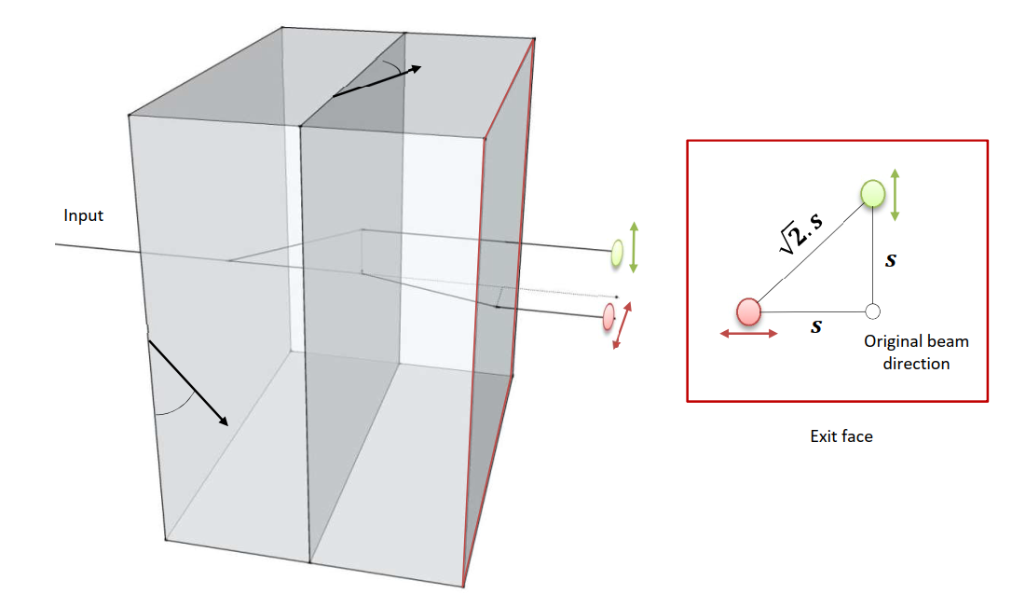
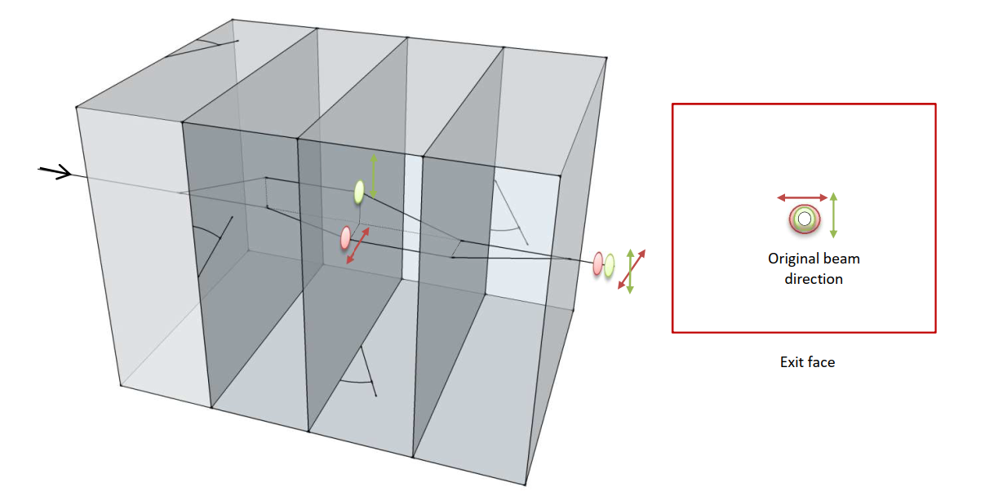








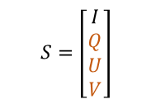

THEMIS new polarimetric analysis scheme - 1
Full-Stokes analyzer (An4) located at the F1 prime focus, delivering dual-beam polarimetry with beam exchange.
Dual-beam (single Savart plate)
$${ S}_{+Q}=\left[\begin{matrix} I \\ +Q \\ \begin{aligned}0 \\ 0\end{aligned}\end{matrix}\right]$$
$${ S}_{−Q}=\left[\begin{matrix} I \\ −Q \\ \begin{aligned}0 \\ 0\end{aligned}\end{matrix}\right]$$
“Beam Splitter”
Input
modulation (QW)
$$S=\left[\begin{matrix}I \\ Q \\ \begin{aligned}U \\ V\end{aligned}\end{matrix}\right]$$
$$S_{V}=\left[\begin{matrix}I \\ V \\ \begin{aligned}Q \\ U\end{aligned}\end{matrix}\right]$$
$$S_{Q}=\left[\begin{matrix}I \\ Q \\ \begin{aligned}U \\ V\end{aligned}\end{matrix}\right]$$
$$S_{U}=\left[\begin{matrix}I \\ U \\ \begin{aligned}V \\ Q\end{aligned}\end{matrix}\right]$$
$$S_{+V}=\left[\begin{matrix} I \\ +V \\ \begin{aligned}0 \\ 0\end{aligned}\end{matrix}\right]$$
$$S_{−V}=\left[\begin{matrix} I \\ −V \\ \begin{aligned}0 \\ 0\end{aligned}\end{matrix}\right]$$
Double Savart plates:
generate the dual beam feature
then superimpose both beams: behave as one, differing only by their linear polarization state.
$$S_{+U}=\left[\begin{matrix} I \\ +U \\ \begin{aligned}0 \\ 0\end{aligned}\end{matrix}\right]$$
$$S_{−U}=\left[\begin{matrix} I \\ −U \\ \begin{aligned}0 \\ 0\end{aligned}\end{matrix}\right]$$
Beam exchange
“DSBS”

Slide 15
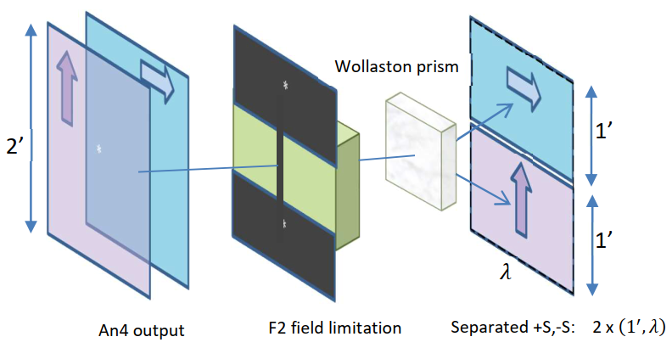
THEMIS new polarimetric analysis scheme - 2
Thanks to THEMIS “polarization friendly” new optical path (geometry of the elevation axis, field rotator, coatings), polarizer output can travel through the telescope and reach the spectrograph cameras “minimally perturbed”
Just in front of each of the spectral cameras, a Wollaston prism splitter separates the superimposed beam into complementary Stokes components to form the spectral focal plane.

